Slide 1

Design Patterns
SoftUni Team
Technical Trainers
Software University
https://softuni.bg

Slide 2
Table of Contents
Definition of Design Patterns
Benefits and Drawbacks
Types of Design Patterns
Creational
Structural
Behavioral

Slide 3
Have a Question?
sli.do
#python-advanced

Slide 4

Definition, Solutions and Elements
Design Patterns

Slide 5
What Are Design Patterns?
General and reusable solutions to common problems in software design
A pattern for solving given problems
Add additional layers of abstraction in order to reach flexibility

Slide 6
What Do Design Patterns Solve?
Patterns solve software structural problems like
Abstraction
Encapsulation
Separation of concerns
Coupling and cohesion
Separation of interface and implementation

Slide 7
Elements of a Design Pattern
Pattern name
Increases vocabulary of designers
Problem
Intent, context and when to apply
Solution
Abstract code
Consequences
Results and trade-offs

Slide 8

Benefits and Drawbacks
Why Design Patterns?

Slide 9
Benefits
Names form a common vocabulary
Enable large-scale reuse of software architectures
Help improve developer communication
Can speed-up the development

Slide 10
Drawbacks
Do not lead to a direct code reuse
Deceptively simple
Developers may suffer from pattern overload and overdesign
Validated by experience and discussion, not by automated testing
Should be used only if understood well

Slide 11



Types of Design Patterns

Slide 12
Main Types
Creational patterns
Deal with initialization and configuration of classes and objects
Structural patterns
Describe ways to assemble objects to implement new functionality
Composition of classes and objects
Behavioral patterns
Deal with dynamic interactions among societies of classes
Distribute responsibility

Slide 13

Creational Patterns

Slide 14
Purposes
Deal with object creation mechanisms
Trying to create objects in a manner suitable to the situation
Two main ideas
Encapsulating knowledge about which classes the system uses
Hiding how instances of these classes are created

Slide 15
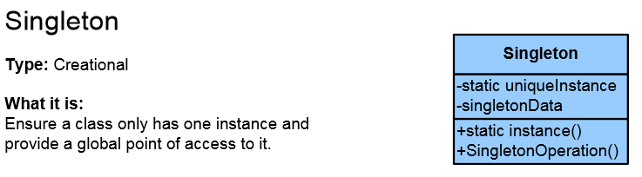
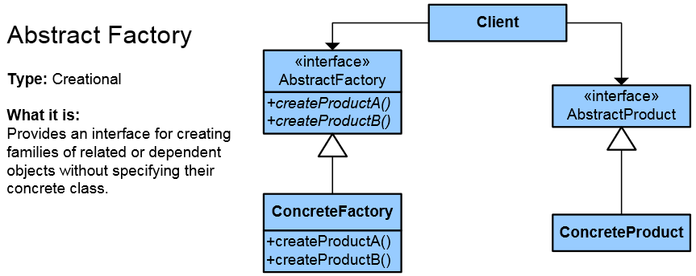
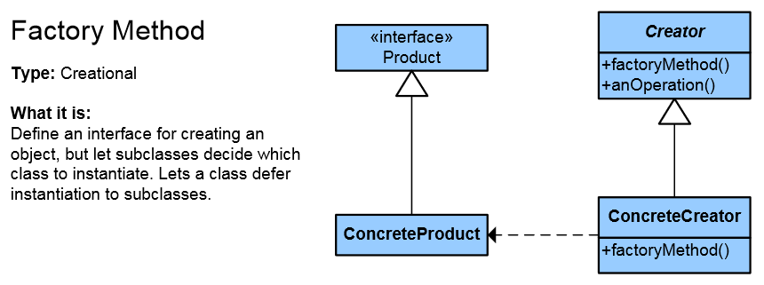
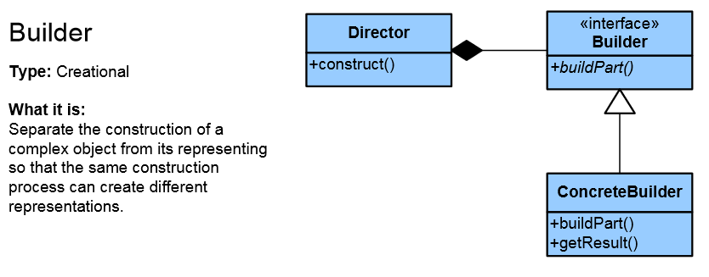
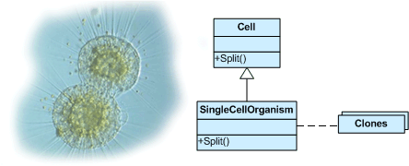
List of Creational Patterns
Singleton
Simple Factory
Factory Method
Abstract Factory
Builder
Prototype
Fluent Interface
Object Pool
Lazy Initialization

Slide 16
Creational Patterns in Python
The language itself provides us with all the flexibility we need to create objects in an elegant fashion
We rarely need to implement anything on top, like Singleton or Factory
Factories are abstraction on top of constructors
Builders are abstraction on top of factories

Slide 17
Singleton
The Singleton pattern is used when we want to guarantee that only one instance of a given class exists during runtime
The Singleton is considered an anti-pattern, because:
It makes the code more complex and less useful
It introduces unnecessary restrictions
It is hard to test

Slide 18
Singleton: Example (1)
def singleton(cls):
instance = [None]
def wrapper(*args, **kwargs):
if instance[0] is None:
instance[0] = cls(*args, **kwargs)
return instance[0]
return wrapper
# Continues on the next slide

Slide 19
Singleton: Example (2)
# Continues from the previous slide
@singleton
class DBConnection(object):
def __init__(self):
"""Initialize your database connection here."""
pass
def __str__(self):
return 'Database connection object'

Slide 20
Factory Method (1)
from abc import ABC, abstractmethod
class DataExporter(ABC):
@abstractmethod
def export(self, data):
pass
class CsvDataExporter(ABC):
@abstractmethod
def export(self, data) -> str:
pass
# Continues on the next slide

Slide 21
Factory Method (2)
# Continues from the previous slide
class DataExporterFactory(ABC):
@abstractmethod
def get_exporter(self) -> DataExporter:
pass
class CsvDataExporterFactory(DataExporterFactory):
def get_exporter(self) -> DataExporter:
return CsvDataExporter()

Slide 22
Abstract Factory (1)
from abc import ABC, abstractmethod
import json
class JsonDataExporter(ABC):
@abstractmethod
def export(self, data) -> str:
pass
class CsvDataExporter(ABC):
@abstractmethod
def export(self, data) -> str:
pass
# Continues on the next slide

Slide 23
Abstract Factory (2)
# Continues from the previous slide
class DataExporterFactory(ABC):
@abstractmethod
def get_json_exporter(self) -> JsonDataExporter:
pass
@abstractmethod
def get_csv_exporter(self) -> CsvDataExporter:
pass

Slide 24

Structural Patterns

Slide 25
Purposes
Describe ways to assemble objects to implement a new functionality
Ease the design by identifying a simple way to realize relationship between entities
All about Class and Object composition
Inheritance to compose interfaces
Ways to compose objects to obtain new functionality

Slide 26
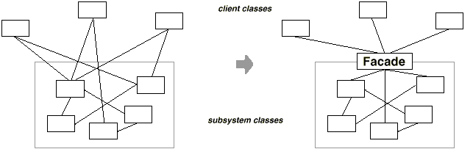
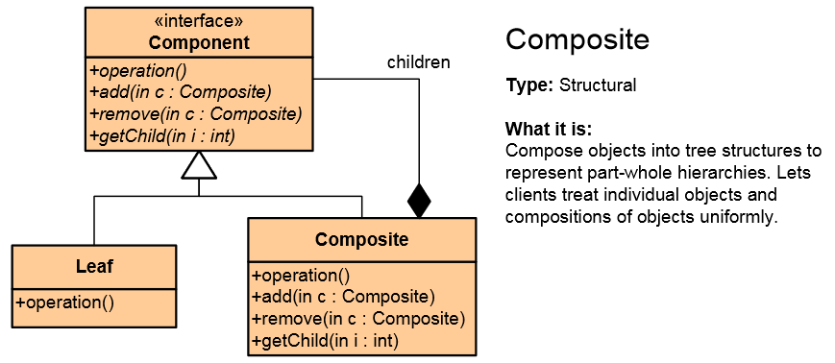
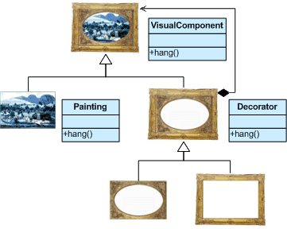


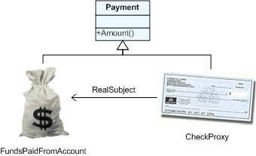
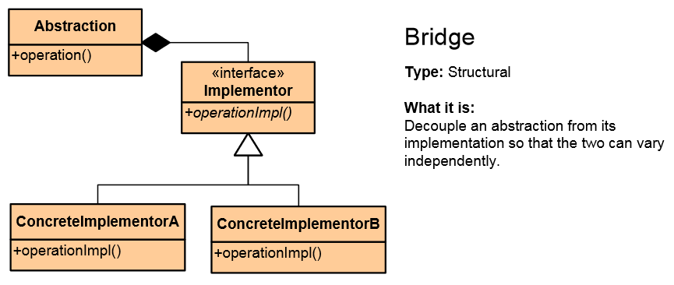
List of Structural Patterns
Façade
Composite
Flyweight
Proxy
Decorator
Adapter
Bridge

Slide 27
Façade Pattern
Provides a unified interface to a set of interfaces in a subsystem
Defines a higher-level interface that makes the subsystem easier to use

Slide 28
Façade Example (1)
class Cook(object):
def prepareDish(self):
self.cutter = Cutter()
self.cutter.cutVegetables()
self.boiler = Boiler()
self.boiler.boilVegetables()

Slide 29
Façade Example (2)
class Cutter(object):
def cutVegetables(self):
print("All vegetables are cut")
class Boiler(object):
def boilVegetables(self):
print("All vegetables are boiled")

Slide 30
Decorator Pattern (1)
from abc import ABC, abstractmethod
class DataSource(ABC):
@abstractmethod
def writeData(self, data):
pass
@abstractmethod
def readData(self) -> str:
pass
class FileDataSource(DataSource):
def __init__ (self, filename):
self._file = filename
def writeData(self, data):
# write data to file.
pass
def readData(self) -> str:
# read data from file.
pass

Slide 31
Decorator Pattern (2)
class EncryptionDecorator(DataSource):
def writeData(self, data):
# encrypt the data
# pass encrypted data to wrapper
pass
def readData(self) -> str:
# get encrypted data
# decrypt it
# return it
pass

Slide 32

Behavioral Patterns

Slide 33
Purposes
Concerned with interaction between objects
Either with the assignment of responsibilities between objects
Or encapsulating behavior in an object and delegating requests to it
Increases flexibility in carrying out cross-classes communication

Slide 34
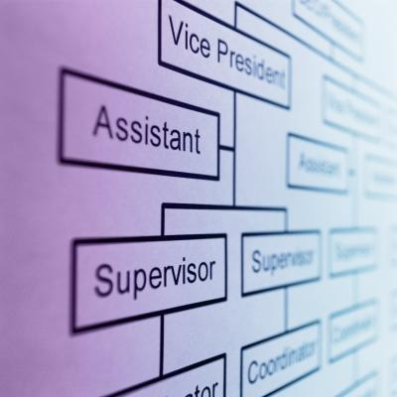
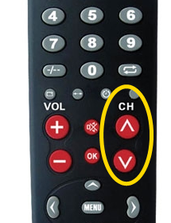
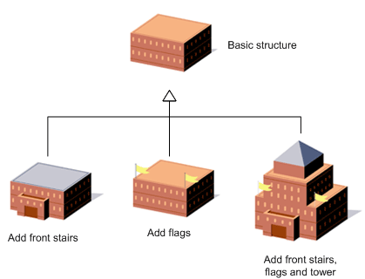
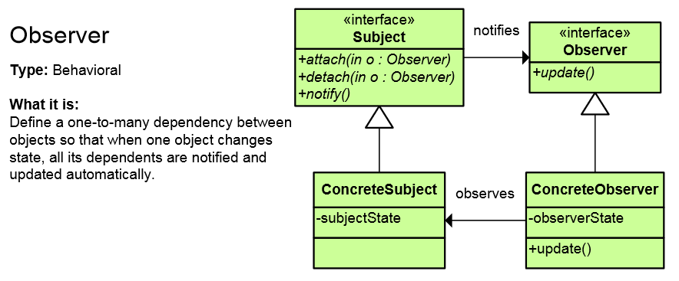
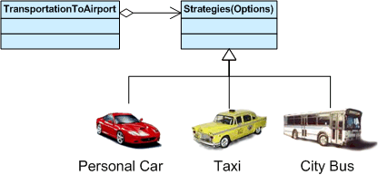
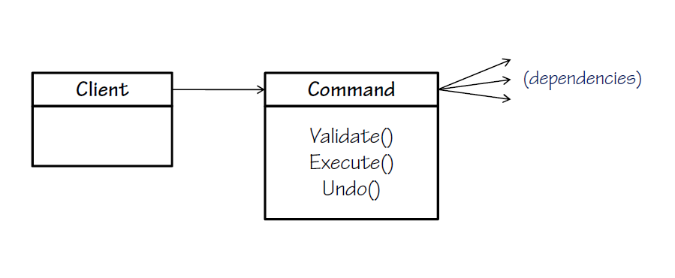
List of Behavioral Patterns
Chain of Responsibility
Iterator
Command
Template Method
Strategy
Observer

Slide 35
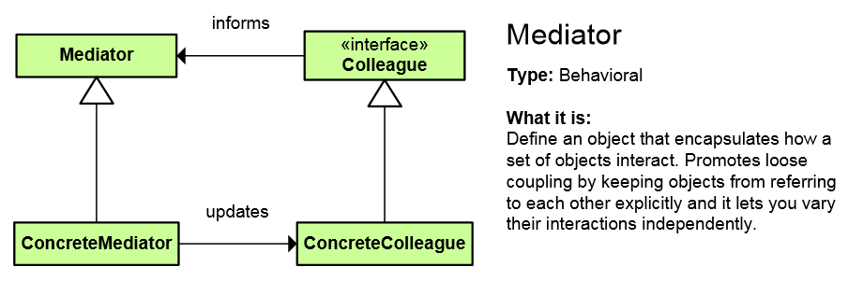
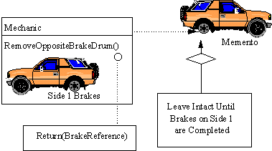
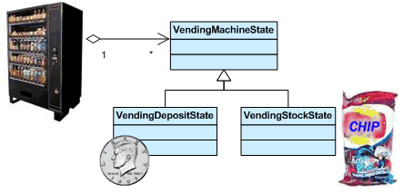
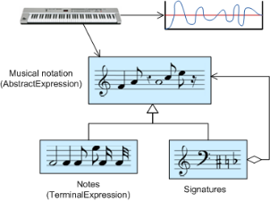
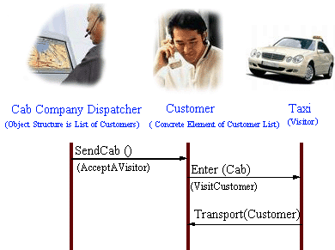
List of Behavioral Patterns (2)
Mediator
Memento
State
Interpreter
Visitor

Slide 36
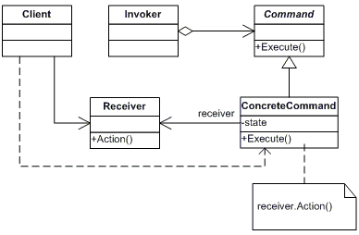
Command Pattern
An object encapsulates all the information needed to call a method later
Let's you parameterize clients with different requests, queue or log requests, and support undoable operations

Slide 37
The Invoker Class
from abc import ABC, abstractmethod
class Invoker:
def __init__(self):
self._commands = []
def store_command(self, command):
self._commands.append(command)
def execute_commands(self):
for command in self._commands:
command.execute()

Slide 38
Command and Concrete Command Class
class Command(ABC):
def __init__(self, receiver):
self._receiver = receiver
@abstractmethod
def execute(self):
pass
class ConcreteCommand(Command):
def execute(self):
self._receiver.action()
class Receiver:
def action(self):
pass

Slide 39
Example
def main():
receiver = Receiver()
concrete_command = ConcreteCommand(receiver)
invoker = Invoker()
invoker.store_command(concrete_command)
invoker.execute_commands()
if __name__ == "__main__":
main()

Slide 40

Summary
…
…
…
Design Patterns
Provide solution to common problems
Add additional layers of abstraction
Three main types of Design Patterns
Creational
Structural
Behavioral

Slide 41
Questions?
Notes:
41

Slide 42












SoftUni Diamond Partners

Slide 43


Educational Partners

Slide 44
Trainings @ Software University (SoftUni)
Software University – High-Quality Education, Profession and Job for Software Developers
softuni.bg, about.softuni.bg
Software University Foundation
softuni.foundation
Software University @ Facebook
facebook.com/SoftwareUniversity
Software University Forums
forum.softuni.bg
Notes:
44

Slide 45

License
This course (slides, examples, demos, exercises, homework, documents, videos and other assets) is copyrighted content
Unauthorized copy, reproduction or use is illegal
© SoftUni – https://softuni.org
© Software University – https://softuni.bg
Notes:
45

